Slide 1


REPORT
World Suicide Cases (1985 - 2016)

Slide 2

CONTENT
Introduction
Which Generation are you?
Analytical Reporting
Conclusion

Slide 3

INTRODUCTION
Suicide is the act of intentionally causing one's own death. Suicide is a permanent solution to a temporary problem. Prior to the late nineteenth century, suicide was legally defined as a criminal act in most Western countries. In the social climate of the early 2000s, however, suicidal behavior is most commonly regarded and responded to as a psychiatric emergency.
This report intends to look at 101 countries in the world from different continents (1985 to 2016). We look at the impact of Gross Domestic Product (GDP) of a country, on its suicide rate, while also considering studying the suicide rate across the different age ranges, sorted as generations. This is base on the year of birth of the victim, and a general overview of the classification.

Slide 4
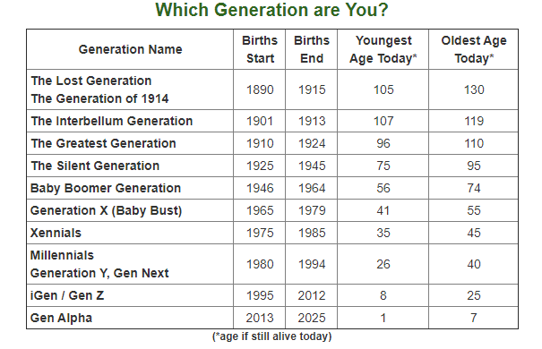

Slide 5
It is obvious from this that Asia, Europe, and Oceania have the highest suicide rate while Africa has the least rate.

Slide 6
A critical look at the report reveals that males commit suicide than the females in all generations. Also, you will see that G.I. Generation and Generation Z occupies the highest and lowest position respectively.
MALES
FEMALES

Slide 7
